Slide 1
The Snow Theorem and Latency-Optimal Read-Only Transactions
Haonan Lu, Christopher Hodsdon,
Khiem Ngo, Shuai Mu, Wyatt Lloyd
Ju-Hyeok Park

Slide 2
Summary
Topic
Read only Transaction memory
Problem
impossibility result that states that no read-only transaction algorithm can provide both the lowest latency and the highest power.
Solution
Propose New algorithm designs.

Slide 3
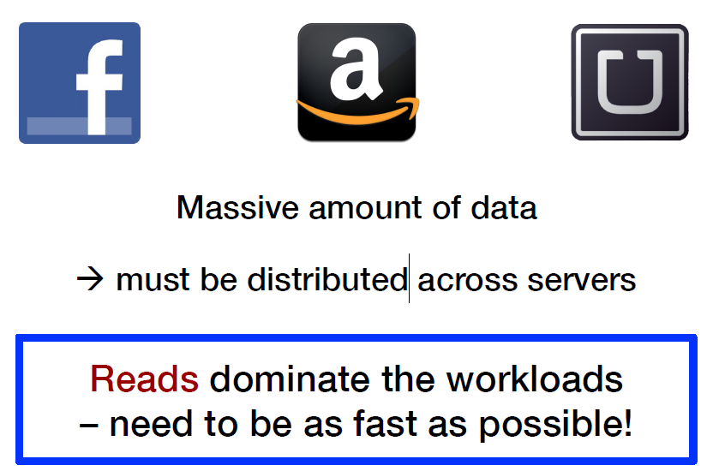
introduction

Slide 4
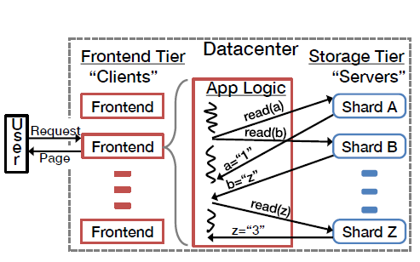
background
A frontend machine receives a request from a user and then runs the application logic to generate her page by reading data across many shards in the storage tier.
All of the reads must complete before the page can be returned to the user.

Slide 5
The SNOW Properties
Strict serializability
Non-blocking operations
One response per read
Write transactions that conflict

Slide 6
The SNOW Properties
Highest Power
[S]trict serializability
[W]rite transactions that conflict
Lowest Latency
[O]ne response per read
[N]on-blocking operations

Slide 7
Strict serializability
ensures there exists a total order over all the transactions in the system.
transactions are serializable—and their results appear to have come from a single machine processing them one at a time.
Strict serializability is the most desirable consistency model because it provides the strongest guarantees.

Slide 8
Non-blocking operations
non-blocking behavior ensures a server can immediately process and respond to requests from clients.
Non-blocking operations are desirable because they directly relate to the latency of the read-only transactions; they save at least the time that would be spent blocking.

Slide 9
One Pesponse Per Read
define one response per read to be the combination of one round-trip to each server and one version per read.
The one version sub property requires that servers send only one value for each read.
The one round-trip sub property requires the client to send at most one request to each server and the server to send at most one response back.

Slide 10
Write transactions That conflict
define the write transactions property as the ability of a read-only transaction algorithm to coexist with conflicting transactions that update data.
first, that a data store allows transactions that update data.
General transactions that read and write data satisfy this requirement, as do weaker write-only transactions that only write data.
The ability to coexist with conflicting write transactions is desirable because write transactions make programming application logic much easier.

Slide 11
Implementation
Rococo is a strictly serializable, distributed data store with general transactions
Rococo was designed primarily for the single datacenter setting we consider here.
Rococo requires the transactions that it executes to be chopped into pieces and analyzed for safety before the system is deployed.

Slide 12
Implementation
first phase distributes pieces of the transaction to the appropriate shards and determines all directly conflicting transactions.
Second phase ensures all shards have the same metadata about directly conflicting transactions.
third phase, which can often be skipped, ensures all shards have the same metadata about transitively (but not directly) conflicting transactions.

Slide 13
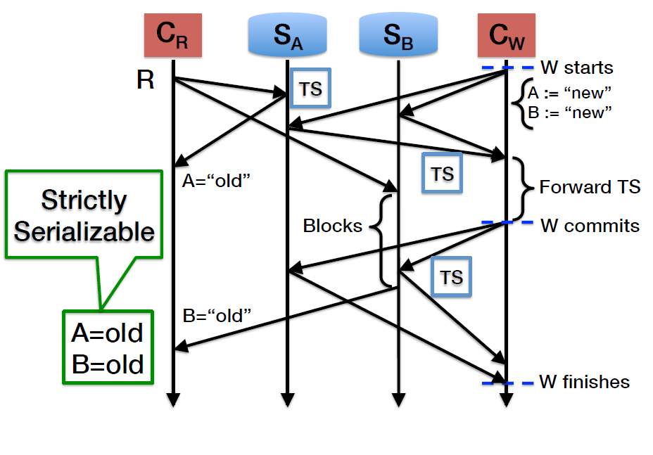
Implementation

Slide 14
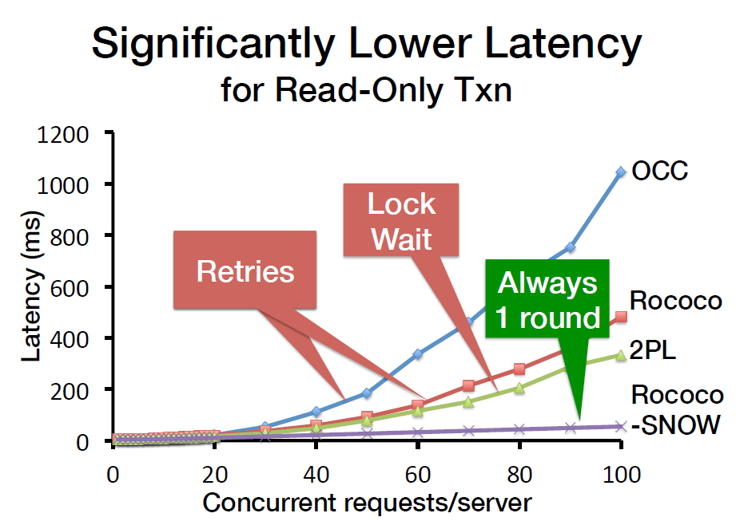
Evaluation

Slide 15
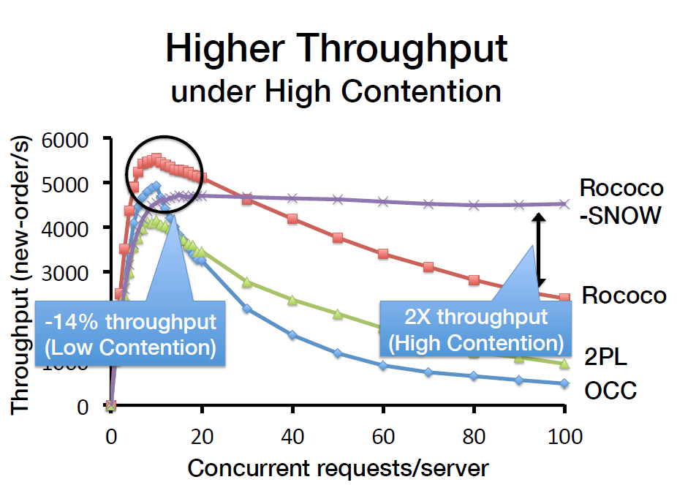
Evaluation

Slide 16
conclusions
The SNOW Theorem for read-only txns
Impossible to have all of the SNOW properties
SNOW helps understand existing systems
Many are not yet optimal
Rococo-SNOW
SNOW Theorem guided SNOW-optimal design
Siginificantly higher throughput and lower latency under high contention

